Slide 1
Chapter 6: Structure
Rosie Brodsky and Sophia Salganicoff

Slide 2
What is Structure?
Structure is the way components of visual expression merge to create an organized whole
Notes:
“What makes a work of art different from the world that surrounds it?”

Slide 3
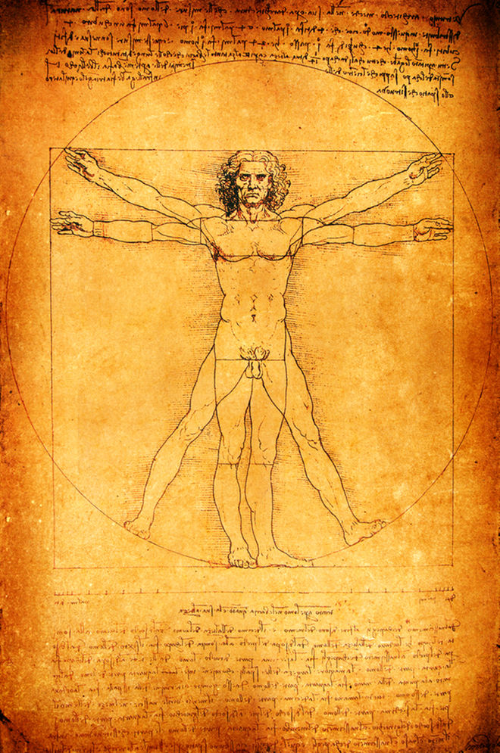
Unity
The sense of visual equilibrium
Leonardo da Vinci. Study of Human Proportions According to Vitruvius
Notes:
How one part of the work is related to another part of the work, with each part demonstrating a logic and integrity that informs the whole
Fibonnacci proportions

Slide 4
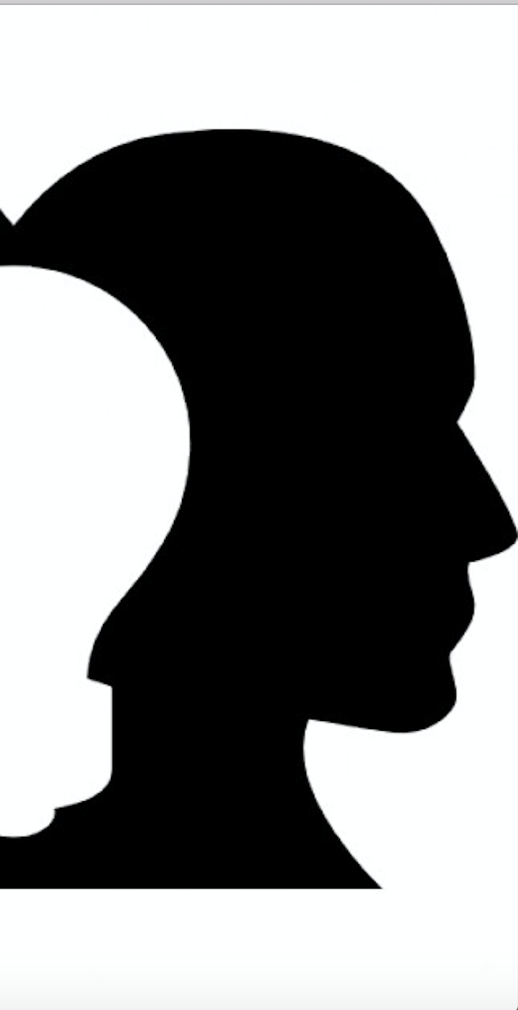
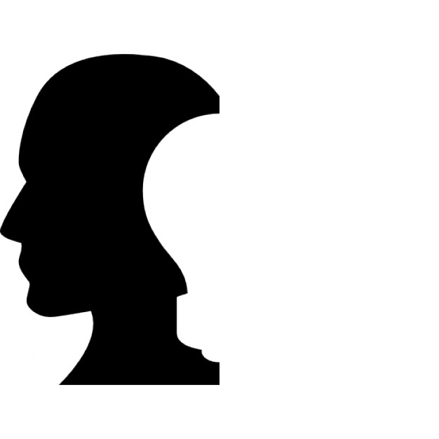
Symmetry
Symmetry is the mirror-like repetition of two halves of an image

Slide 5
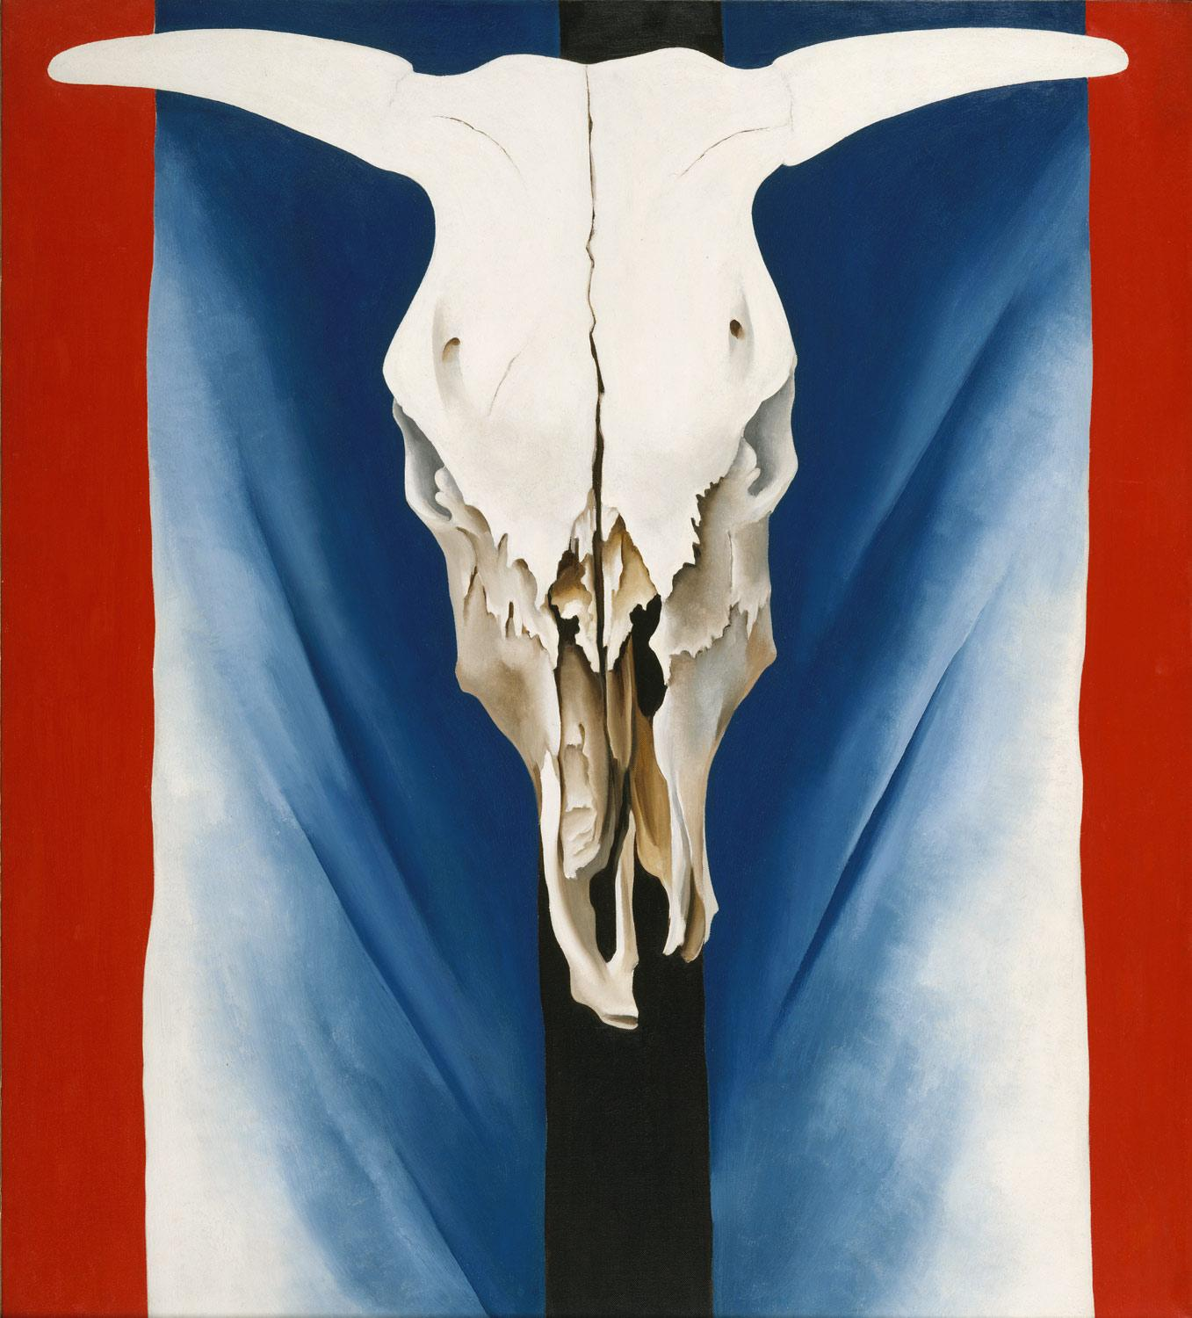
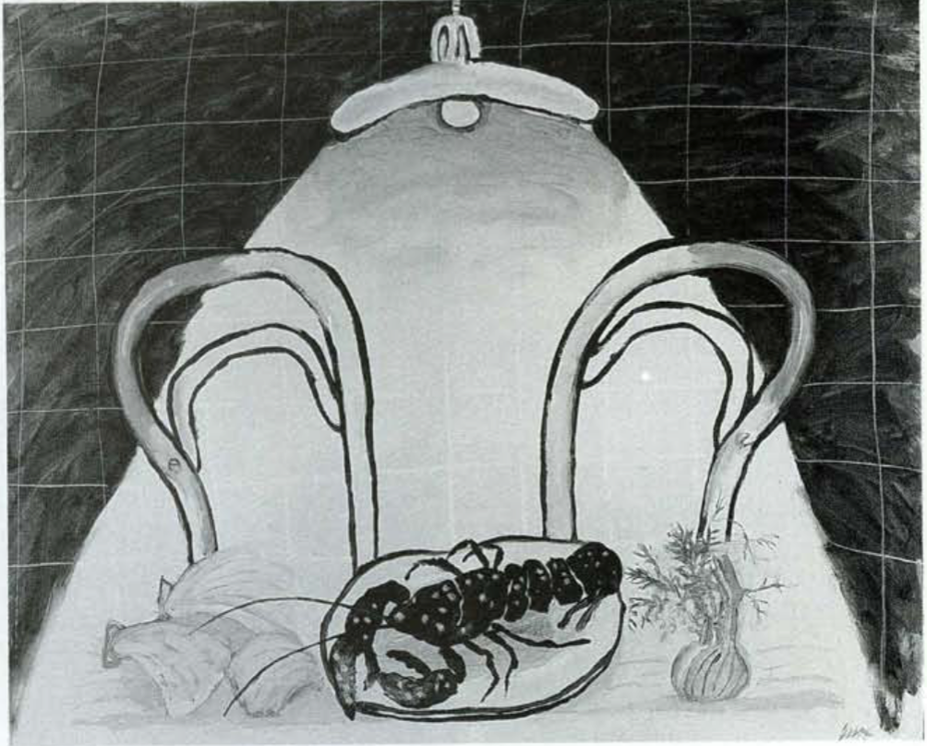
Symmetry cont’d
Georgia O’Keeffe. Cow’s Skull: Red, White, and Blue
Jack Knox. Kitchen

Slide 6
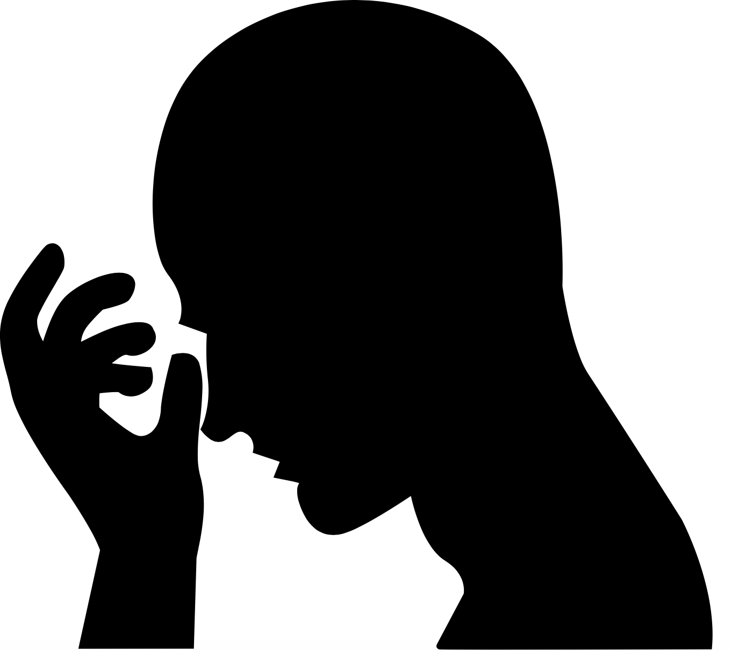
Asymmetry
The arrangement of dissimilar parts to create a balanced whole
“A position dead center is so stable as to have no dynamic tension at all”- Freeman
Notes:
“A position dead center is so stable as to have no dynamic tension at all”- Freeman

Slide 7
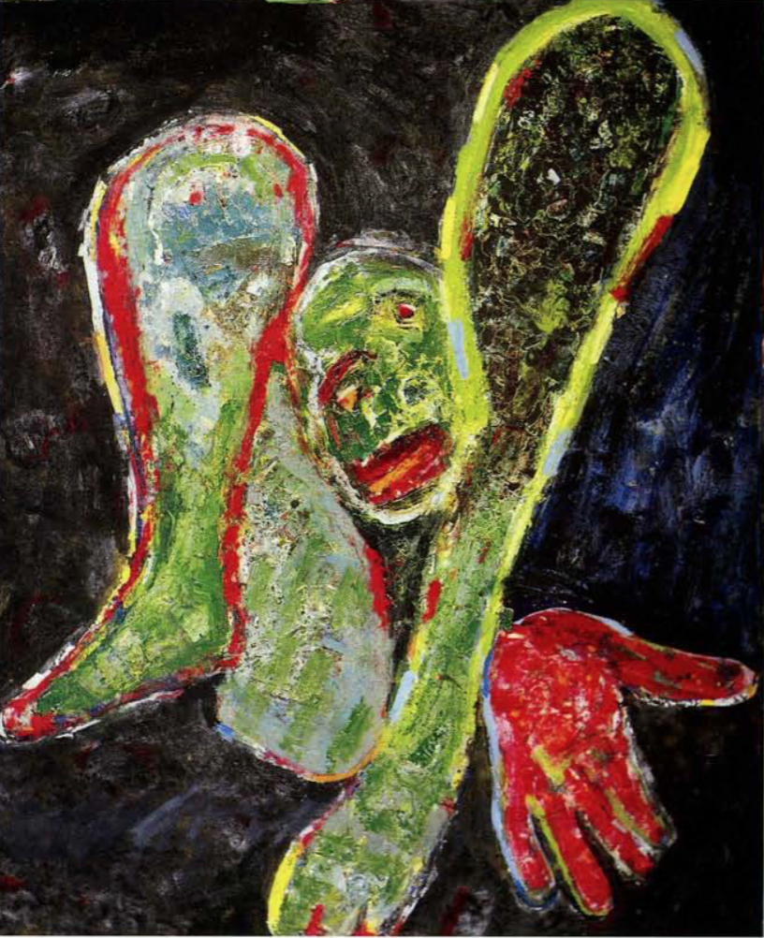
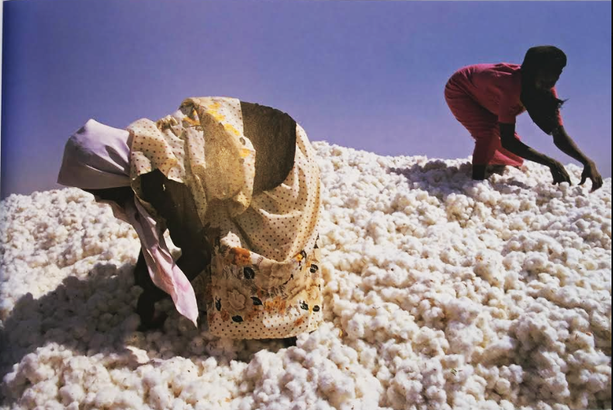
Asymmetry cont’d
George McNeil. Everyman #2
Freeman, 45

Slide 8
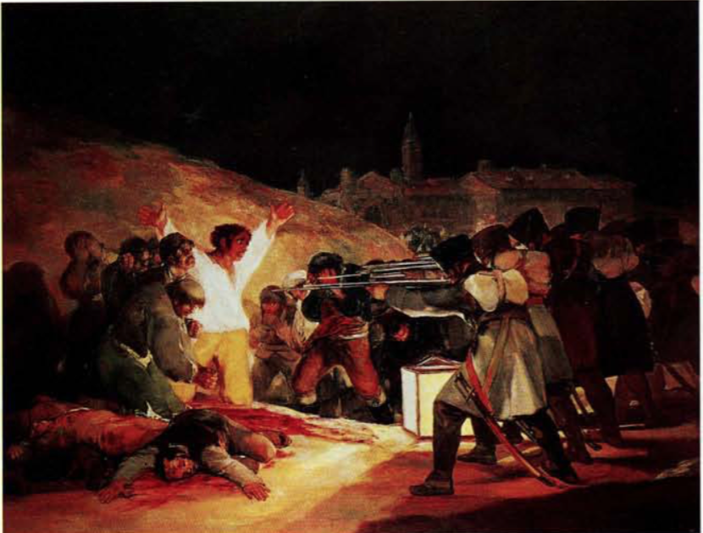
Approximate Symmetry
Two clearly differentiated halves of a composition that allude to a centralized axis
Francisco de Goya. The Executions of the Third of May

Slide 9
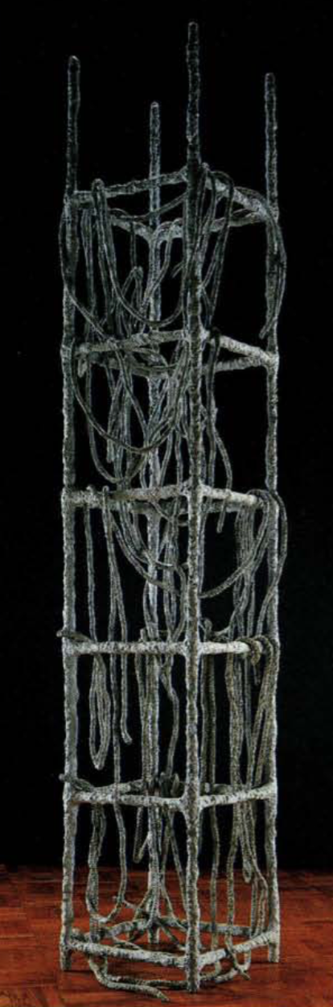
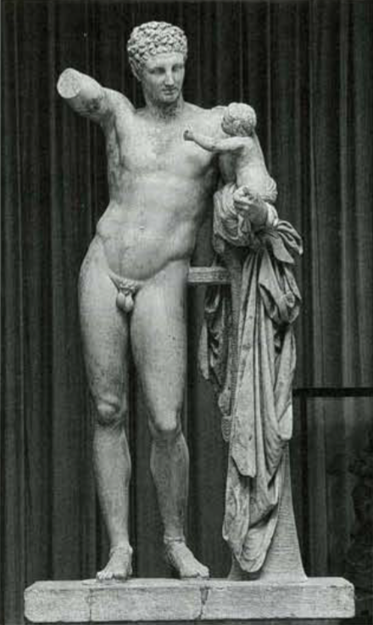
Contrast
The relationship established between two completely different elements or forces
Eva Hesse. Lacoӧn
Praxiteles. Hermes and the Infant Dionysus
Notes:
Contrast allows us to measure and compare

Slide 10
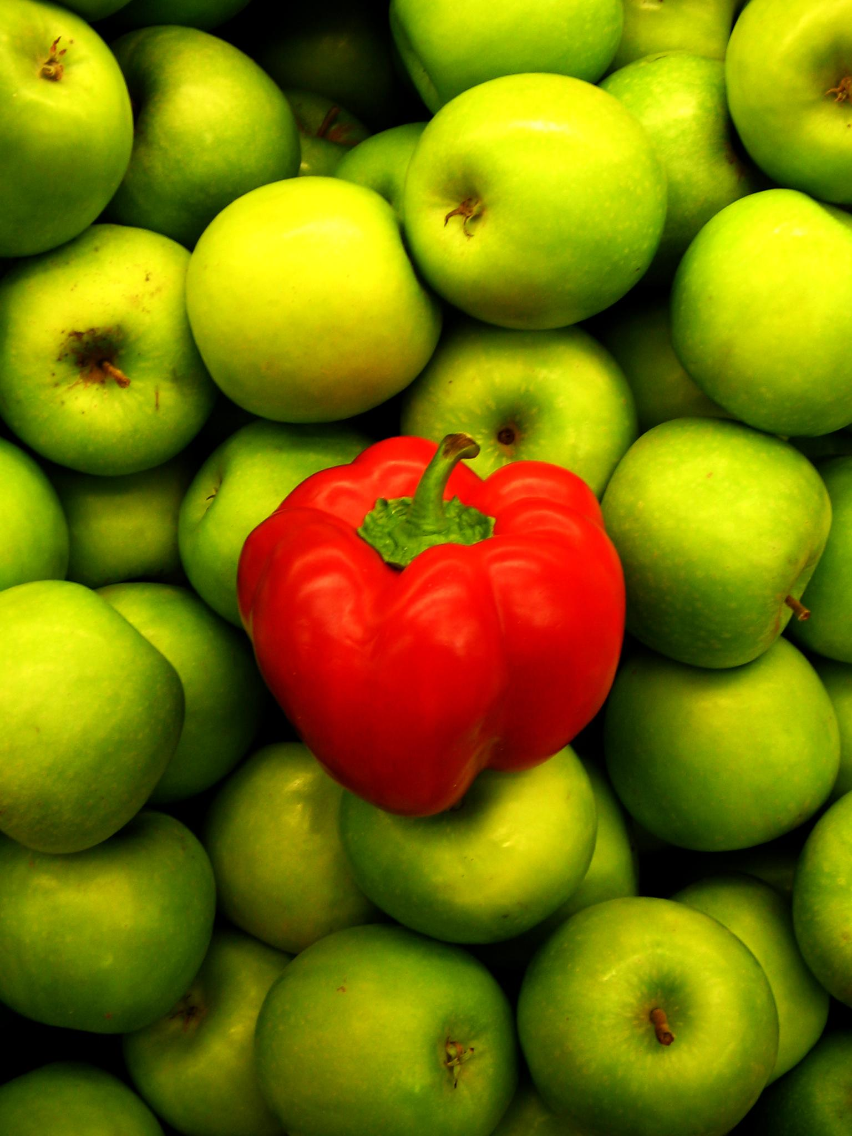
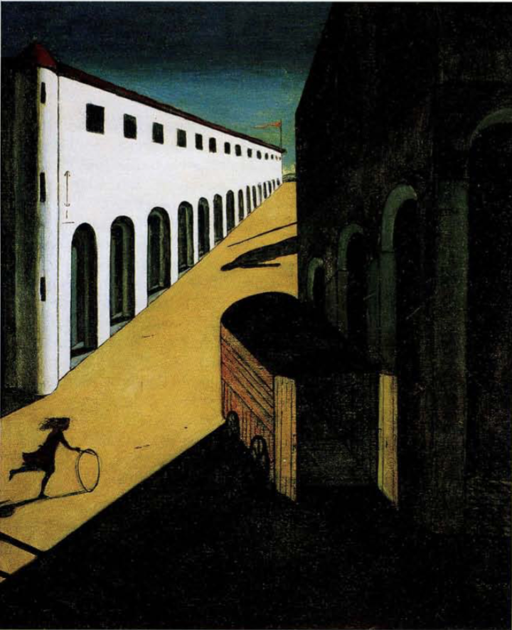
Contrast
Giorgio de Chirico. Mystery and Melancholy of a Street
a2ua.com

Slide 11
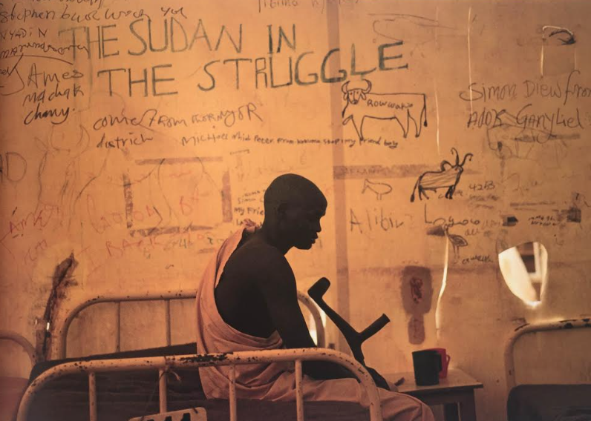
Focal Point
The main point of focus in a particular image or object
Freeman, 61

Slide 12
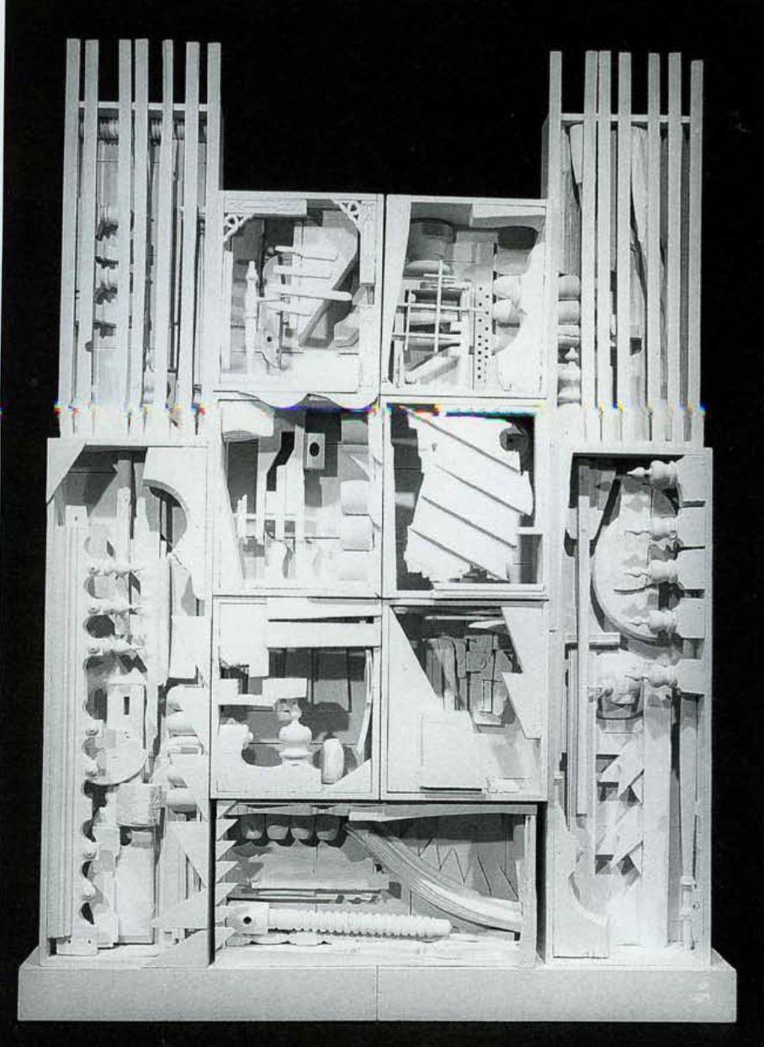
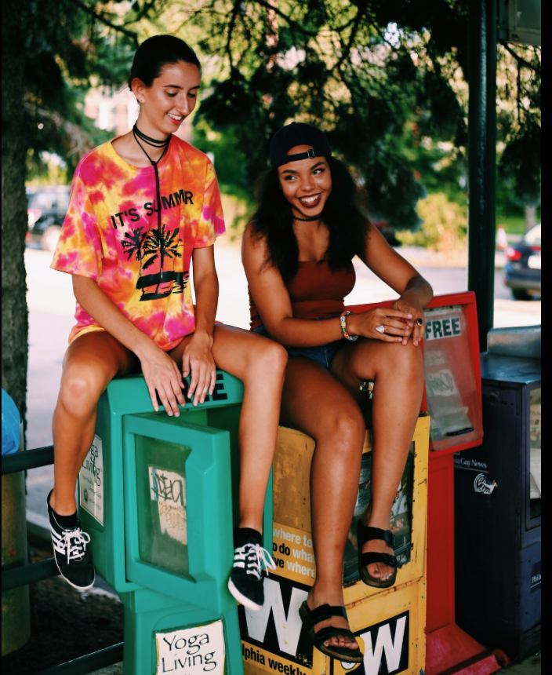
Multiple Focal Points
Multiple Focal Points
Various points of focus that bring the component parts of an image into an ordered whole
Sam Gamberg
Louise Nevelson. Dawn’s Wedding Chapel II

Slide 13
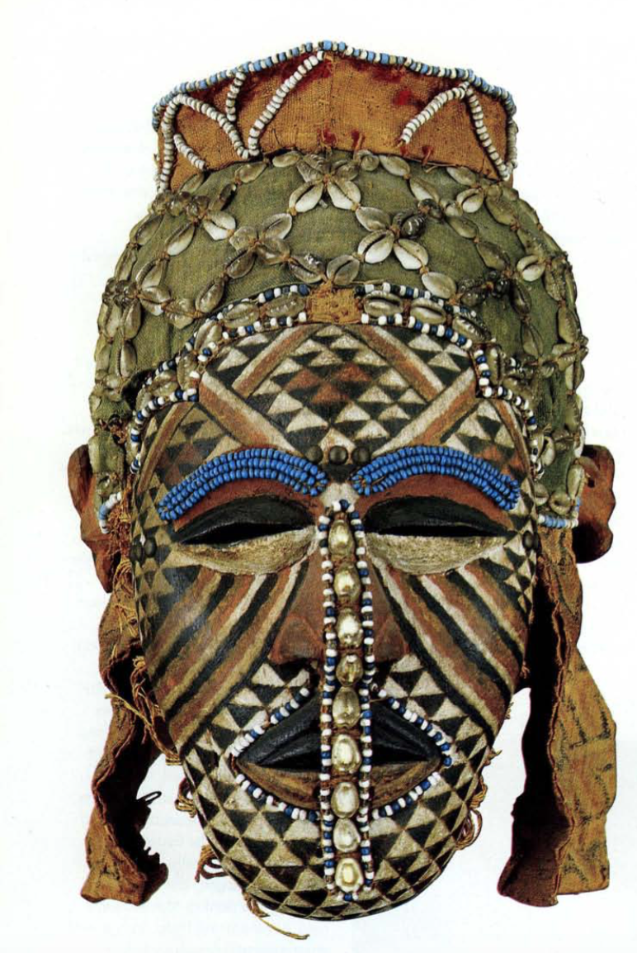
Repetition
Principle of Repetition: Repeat some aspect of the design throughout the entire piece
Mask, African (Kuba)

Slide 14
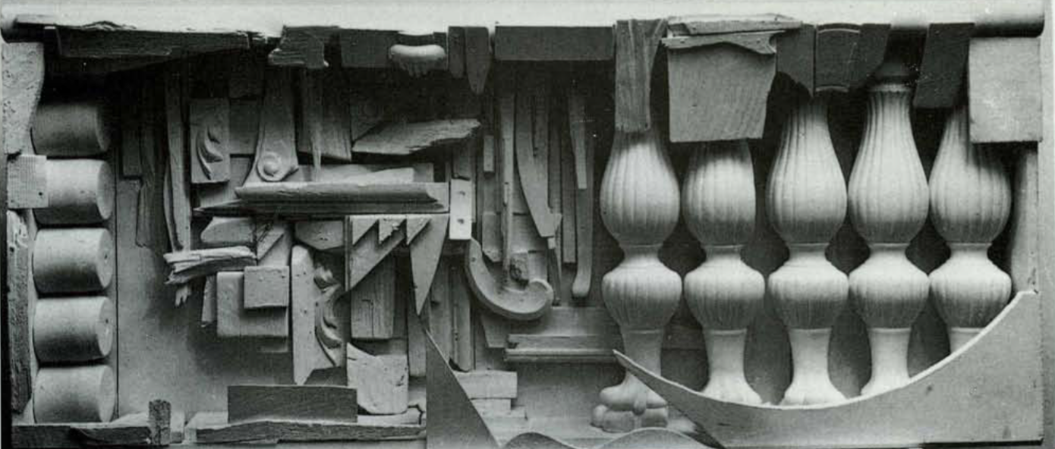
Alignment
Principle of Alignment: Nothing should be placed on the page arbitrarily. Every item should have a visual connection with something else on the page
Louise Nevelson. Case With Five Balusters

Slide 15
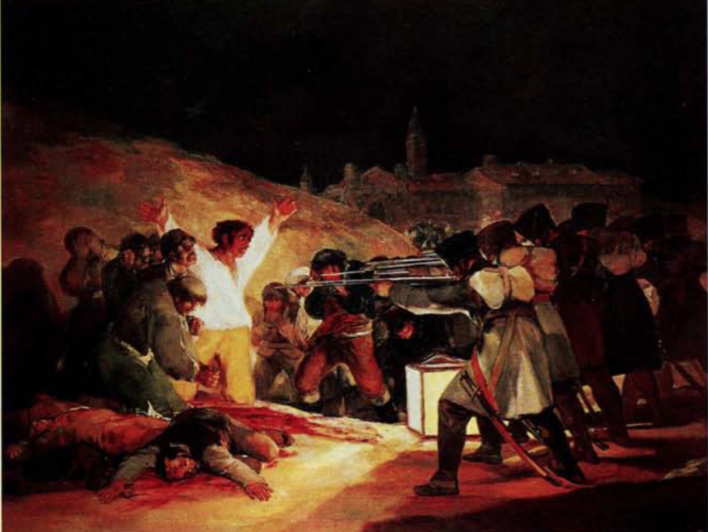
Proximity
Principle of Proximity: Group related items together, physical closeness implies a relationship
Francisco de Goya. The Executions of the Third of May

